Slide 1

Introductory Training
Made by
Daniel Herman Ph.D.
Helle Thorning, Ph.D.
Present by Birthe Povlsen
National Board of Social Services

Slide 2
CTI Model Details

Slide 3
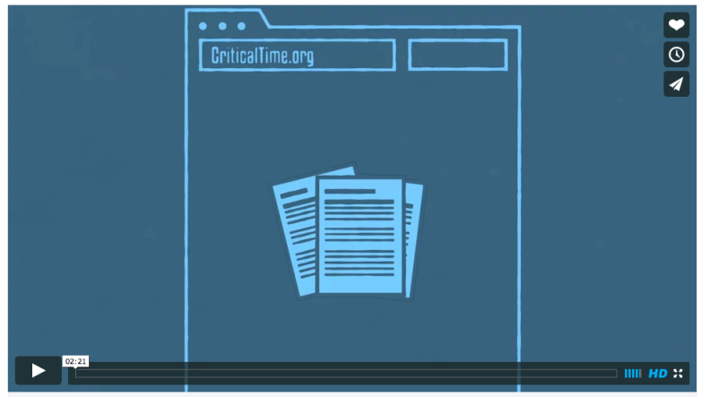
Notes:
2 Minute Video link embedded. Video file can be supplied if needed.

Slide 4

Fort Washington Armory Men’s Shelter, 1990s
Notes:
Our story begins here at the Fort Washington Armory in upper Manhattan in the early 1990s. This large men’s shelter was among many that opened around this time, as New York City was struggling under the weight of the homelessness crisis.
Up to 1000 men would sleep on cots on drill floor, many with SMI and substance abuse, untreated medical problems including HIV and TB.
After a while, onsite MH and case management services were added to provide outreach, treatment and stabilization----and NY/NY led to placement into housing for many.

Slide 5
How does CTI differ from traditional case management?
Notes:
Time limited
Three phases
Focused
Reducing intensity
Explicit linking emphasis

Slide 6
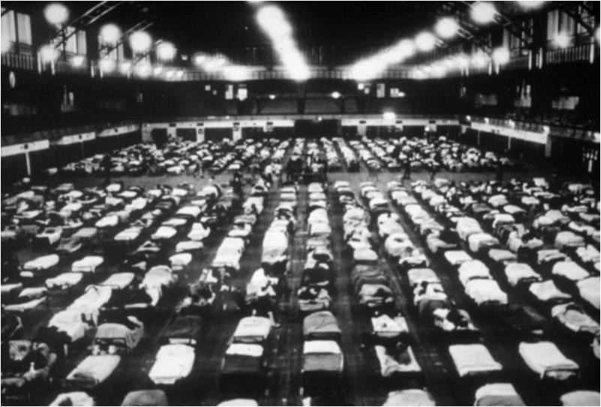

CTI aims to solidify supports as it spans the period of transition
CTI
Notes:
We developed CTI as a way to augment our services so that support and continuity of care would be enhanced during the critical time of transition from shelter to community housing.
We thought that a time-limited intervention might have a durable impact if it helped to strengthen a network of community support. CTI emphasizes maintaining continuity of care while gradually passing primary responsibility to supports in the community.

Slide 7
critical time of transition?
Often characterized by energy & renewed sense of hope
Client may be open to trying new things
Barriers to successful community integration can be identified and removed
Opportunity to establish long-lasting connections to the community

Slide 8



CTI differs from traditional case management
Time limited
Focused
Three phases
Notes:
CTI is a time-limited model delivered by a case manager who has existing relationship with the service recipient. It was designed to provide emotional & practical support during a period of transition for the citizen, for instance, during the transition from living in a shelter to placement in housing in the community.
It is highly focused on a small number of service areas that place the individual at risk of becoming homeless again. Thus, it is very individualized.
Gradually, the case manager begins to transfer responsibility to community caregivers over a nine-month period that is divided into three specific phases.
The case manager’s primary role is to strengthen ties to services, family, friends, creating a community network that will continue to provide support to the citizen long after the CTI intervention is over.
Three phases with specific aims.
Phases are defined by the model NOT the “readiness” of the service recipient.

Slide 9
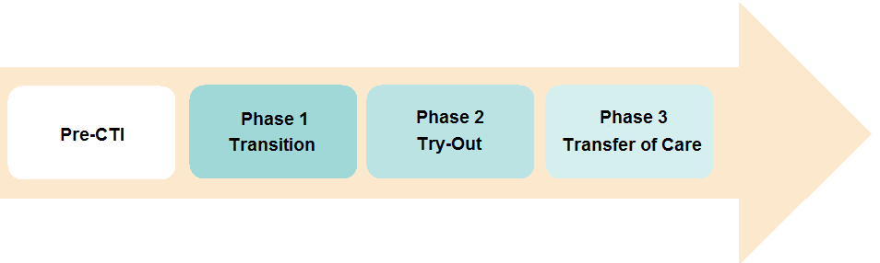
Phases

Slide 10
Unlike some other models
Timing of movement through phases is defined by program model NOT client readiness
Why is this counterintuitive?

Slide 11
Why “Pre-CTI”?
Developing rapport before the transition increases likelihood of successful engagement
Because CTI is time-limited, a headstart can make a big difference
Can provide advance information about citizen’s needs and preferences
Notes:
Amount of pre-CTI contact depends on access and feasibility issues (geographic, institutional constraints). For example, it may be difficult to have face-to-face meetings with persons who are incarcerated or living somewhere far from where the CTI worker is based. In this case, telephone or video contact may be considered. Sometimes the citizen assignment (or date of discharge) is unknown or unpredictable, making it challenging to schedule pre-CTI visits in a timely way.
The evidence for the importance of pre-CTI contact is still being developed, however it was supported by findings from our second randomized trial.

Slide 12
Phase Details & Case Examples

Slide 13
Phase One
Transition
Outreach and Linking
Notes:
Implement transition plan while providing emotional support
The CTI worker provides direct emotional and practical support to the citizen and begins to link citizen to people and resources that will gradually assume primary role of providing needed supports

Slide 14
Home visits
Assess citizen needs & preferences
“Introduce” citizens to providers
Meet with caregivers
Substitute for caregivers
Connect caregivers to each other
Assess potential of support system
Help negotiate ground-rules for relationships
Mediate conflicts
Notes:
During the Transition phase, the CTI worker has a high level of contact with citizens.
He escorts them to their new residence and visits them regularly to evaluate their adjustment to community living.
He also accompanies citizens to the first community mental health appointment to help smooth this experience.
Mediate conflicts between citizen and prospective network of support (formal and informal)
The CTI worker also works with citizens to strengthen their ability to advocate for themselves.
Continuing assessment of needs in community

Slide 15
Engagement?
Active outreach
Introduce yourself and how you can be helpful
Repeated, predictable, non-intrusive patterns of interaction
Respond to felt needs
Respect boundaries
Allow people as much control as possible
Be patient, persistent & genuine
Educate citizen about services provided

Slide 16
Dynamic assessment in CTI
Pre-CTI | Determine citizen’s most immediate needs and concerns
Phase 1 | Assess citizen’s current needs and possible sources of support
Phase 2 | Assess functioning of citizen’s community connections
Phase 3 | Assess transfer of care plan and outlook going forward

Slide 17
Goalsetting
Shared decisionmaking is the core of goal setting
Not all goals can be achieved in a phase
Other providers may be working on other goals with citizen
CTI worker must separate citizen goals from her/his own hopes for the citizen
Goalsetting is a negotiation (CTI worker & citizen must prioritize citizen’s choices together)

Slide 18
Focus areas
Finances
Housing crisis management
Psychiatric treatment and medication management
Substance use
Family relationships
Notes:
These areas are the typical ones that are important for working adults with SMI in urban US settings. How would they look different with different populations and in Danish settings?

Slide 19
Small Group Exercise
Identify focus areas that would be relevant to your target population
Notes:
EXERCISE: Identify likely focus areas relevant to specific target populations that will receive CTI services.

Slide 20
Why home visits?
Engage citizen
“In-vivo” assessment of needs and supports
Engage potential supporters in collaborative way

Slide 21
What is active linking?
Distinguish from “service referrals”
Strategies?

Slide 22
Negotiate and mediate
Clarify expectations of citizen and supporters
Mediate conflicts as they arise
Introduce and link supporters when feasible

Slide 23
Phase Two
Try-Out
Facilitate and test citizen’s problem-solving skills capacity of the support system
Notes:
By the time the Try-Out phase begins, the basics should be in place.

Slide 24
Monitor effectiveness of support system
Modify as necessary
Less frequent meetings
Crisis intervention and troubleshooting
Notes:
The CTI specialist steps back a bit and observes how study the new community linkages are. He encourages the citizen and members of the support network to handle more on their own.
If the system seems to be operating smoothly, the CTI worker can become less active.
Most likely, however, problems arise which will require continued mediation, advocacy and sometimes development of new support arrangements

Slide 25
Working Effectively with Other Providers
Inform provider of your involvement as citizen’s advocate
Recognize each program has unique service & outcome goals
Ask about and understand the expectations for participants
Follow up with any information required for admission
Be persistent, patient and accessible

Slide 26
Phase 1
Phase Three
Transfer of Care
Terminate CTI services with support network safely in place
Notes:
During Phase 3, the CTI specialist, the citizen and community linkages hold a meeting to discuss transfer of care and go over long-term goals. Ideally, this discussion should take place 1-2 months before the end of CTI to allow time to work through any snags.
Key issue at this phase is dealing with the end of the CTI relationship. The citizen and CTI worker need to review and reflect on the work they have done together – where the citizen was at the beginning, where he moved during the intervention and what possibilities lie ahead.
The two should discuss the citizen’s strengths, new skills, vulnerabilities and “safety net” that is in place should the citizen need it.
A celebration is a nice way to mark the end of the CTI relationship.

Slide 27
Consultation but little direct service
Ensure key caregivers meet and agree on long-term support system
Formally recognize end of intervention and relationship
Notes:
Formal ending is especially imp

Slide 28
Transfer of Care: Confirming Long-term Supports
Increased contact with providers but decreased contact with citizen
CTI worker should be finalizing community supports
Care providers/supporters must communicate with each other to maximize results
Termination of relationship issues may arise

Slide 29
Why is a formal ending so important?
To citizen
To support network
Notes:
Citizen may have experienced many losses in her or his life and it is important not to repeat or re-stimulate experience of traumatic loss
Support network members need to know that CTI worker is no longer in the picture and to be sure that they understand responsibilities and roles

Slide 30
Common termination concerns
Citizen
Anxiety
Avoidance
Sense of loss/ abandonment
Acting out
Worker
Anxiety
Avoidance
Guilt

Slide 31
Approaching the ending
Explore and normalize feelings citizen may have
Discuss the gains made
Explore current coping skills, current supports
Explore risks associated with loss of relationship and plan to address them
Hold a graduation ceremony/party or ritual

Slide 32
Add Case Example
Provide example, preferably using Danish setting. Could be based on one of our cases developed for other trainings. Example created for Australia training follows as a guide.

Slide 33
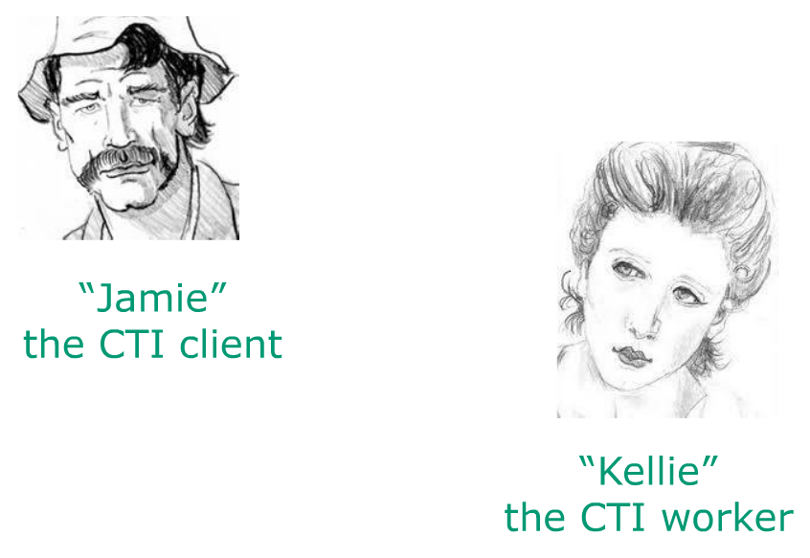
Screening for Eligibility

Slide 34
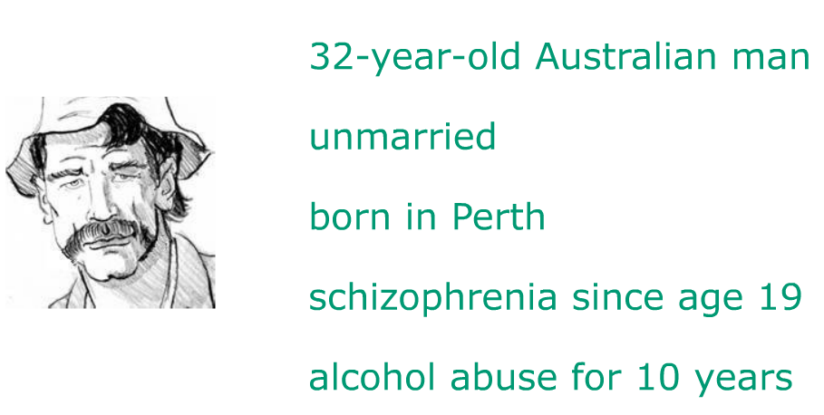
Screening for Eligibility
Jamie

Slide 35
Pre-CTI Phase: Engagement From referral to move-in
CTI worker becomes familiar with citizen’s history and develops an initial trusting relationship with him

Slide 36
Screening for Eligibility
Pre-CTI Task 1
Collaborative Assessment
From Jamie’s chart, Kellie becomes familiar with his history since the first psychotic episode She will need this information when linking him to community supports
Many hospitalizations
Several long episodes of homelessness
Multiple suicide attempts
A good advocate for himself (he negotiated individualized funding with mental health commissioner)

Slide 37
Screening for Eligibility
From Jamie himself:
Despite impairments, worked 10 years in sheltered employment as a laborer
She learns about his support network
adoptive parents in Rockingham, very supportive (modified VRO to allow them to visit him)
adoptive sister, doesn’t want Jamie near her kids
She learns about his goals and meaningful activities
strong desire to have own place
enjoys fishing

Slide 38
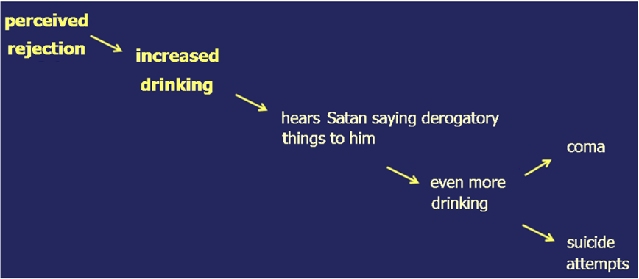
Screening for Eligibility
A risky pattern of behavior
Kellie will need all this information when linking Jamie to community supports during Phase 1

Slide 39
Screening for Eligibility
Pre-CTI Task 2
Engaging the citizen
In the first month, Kellie & Jamie meet informally once or twice a week
Jamie begins to trust her
Early rapport is essential because during periods of transition the risk of losing citizens can be high

Slide 40
Phase 1: Outreach & Linking
CTI worker provides direct support to citizen and begins to link him to people and agencies/programs that will gradually assume primary role of delivering ongoing support.

Slide 41
Screening for Eligibility
Phase One Task 1 Planning for Phase 1
Create a plan for the phase
Worker and citizen meet to collaborate on a plan
Each plan focuses on only a few domains
Shared decision-making approach

Slide 42

Screening for Eligibility
Task #2: Linking Citizen to Supports
Kellie drives Jamie from inpatient unit to new residence
She uses brokerage funds to purchase furniture
Kellie, Jamie and adoptive parents meet
Kellie links Jamie to supported employment job as a gardener (two days a week)
She links him to a fishing club (once a week)
Notes:
(1 min) Another essential task of Phase 1 is linking the citizen to community supports.
Lena accompanied Adam on the day that he moved from the hospital into his new community residence.
She met with Adam and his case manager at his residence. At the meeting, she summarized Adam’s history. They all agreed to work on substance abuse and to help him reach his goal to be trained as a substance abuse counselor.
After getting Adam’s permission, Lena called his sister in New Jersey and explained to her that, for the next nine months, she would be helping to strengthen Adam’s support network in order to integrate him in the community. It’s important not to wait until there is a crisis to talk to the family.
Lena put the sister in touch with the case worker to help them see that they were part of a larger social network that would have to work together to help Adam.
Lena scheduled a second visit to Adam for the following week in order to evaluate his adjustment to community living.

Slide 43
Phase 2: Try-Out
CTI worker gradually steps back to monitor the citizen’s support network and his needs and skills. She encourages him to take more responsibility.

Slide 44
Screening for Eligibility
Phase 2 Task #1 Planning for Phase 2
Kellie and Jamie assess if Phase 1 objectives have been met
Links to Jamie’s community supports are in place
Jamie regularly attends substance abuse group
They identify an emerging need for Phase 2
Jamie is facing a crisis
They identify housing as one focus area for Phase 2

Slide 45
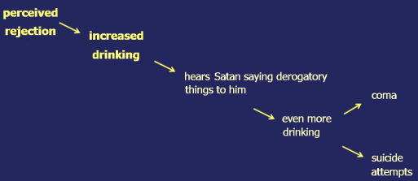
Phase Two Task #2 Monitoring supports & skills
Crisis = Jamie’s adoptive sister invites their parents to her Christmas party next Thursday, but doesn’t want Jamie to come.
Last year, when the same thing happened and Jamie was alone on Christmas day, he drank so much he was hospitalized
Remember Jamie’s
risky pattern
Kellie proposes the idea to him of going out with his parents to their favorite restaurant the day after Christmas
The plan is a success: it prevents Jamie from feeling rejected and prevents him from overdrinking on Christmas Day

Slide 46
Phase Two Task #3 Negotiate to strengthen system of supports
Because of Jamie’s mental illness, the DSC worker, John, will not meet with him to find an AOD group – he isn’t sure if he can handle it if Jamie shows up drunk and psychotic
Kellie negotiates with John – she offers to accompany Jamie to the appointments
John is reassured that there will be someone at the initial meetings who knows Jamie
After a few times, John begins to meet Jamie alone
he rings Jamie first to verify his state
if he is unsure, he asks Kellie to check

Slide 47
Phase 2 Task #4 Helping citizen improve skills for community living
Jamie needs a job to keep himself busy or he will continue to drink all day
Kellie encourages him to practice problem solving, to weigh the advantages and disadvantages of different options
Is this option of interest to him?
Is it within his capacity?
Is it in a convenient and safe location?

Slide 48
Phase 3: Transfer of Care Months 7-9
CTI worker focuses on:
Assuring that support network is safely in place
Finalizes transfer of care to support network
Terminates active intervention

Slide 49
Phase 3 Task 1 Monitor that links can function independently
Kellie backs off, maintaining monthly check-in contact with Jamie
She encourages communication between links

Slide 50
Phase Three Task 2 Transferring Care
Kellie organizes a Transfer of Care meeting with citizen and key members of primary support network
Kellie sends a copy of their agreement and phone numbers to each person

Slide 51
Phase Three Task 3 Terminating Active CTI
Kellie holds a final meeting with Jamie, celebrating how far he has come and what he has accomplished
Jamie tells Kellie, “It’s been good having you here to help work things out.”
Jamie is motivated about holding onto his job. He said, “My life so far was about having fun.” He realizes now that he needs to work to stay on in his housing.

Slide 52
Group exercise
Break into groups and each group creates a case that would illustrate how CTI might work with particular target population/setting
Discuss examples of with focus on issues and activities that the CTI worker might carry out in each phase

Slide 53
Feedback & Dialog
Use this time to reflect on:
How comfortable you are with the content and it’s applicability to your target population
&
How you would strategies implementation with your target population
&
What else do you need as a trainer?

